Slide 1

Sentimental Analysis Using ensemble of Naive Bayesian, Logistic and Decision Tree Algorithm
Submitted by,
Sabyasachi Chakraborty
18MCA0234
Pratik Kumar Dutta
18MCA0203
Sahil Gandhe
18MCA0207
Under the guidance of, Dr. Sumaiya Thaseen I
(Associate Professor) School of Information Technology and Engineering

Slide 2
Abstract
In this presentation, a sentimental analysis is performed using an ensemble of Naive Bayesian Classification, Logistic Regression and Decision Tree Algorithm. In this technique, the polarity (state of having two opposite opinions) of the expressions is calculated. With this approach, the system is able to automatically predict the approximate outcome for a large subset of sentiment expressions by deploying efficient algorithms that are significantly better and thereby achieving results in minimal span of time.

Slide 3
Introduction
Sentiment analysis is the task of identifying and categorizing opinions expressed in a piece of text, especially in order to determine whether the, product is positive, negative or neutral.
Different application like emotion detection and Crime identification, Age prediction, Selection and Multilayer perceptron can be done using: 1. Naive Bayesian, 2. Logistic Regression and 3. Decision Tree Algorithms.

Slide 4
Literature Survey
Naive Bayesian Classifier - Rapid Assignment of rRNA Sequences :
Different Rapid Assignment of rRNA sequences are implemented by Naïve Bayesian Classifier algorithm.[1]
Accuracy level is 95%.
RDP (The Ribosomal Database Project) Classifier which provides data, tools, and services related to rRNA sequences to the research community was tested with a corpus (a collection of written text) of 23,095 RNA sequences.

Slide 5
Literature Survey
Logistic Regression - Spam Recognition using Logistic Regression :
Spamming is the misuse of Email to send unwanted bulk message described by author [2].
It is a serious problem for an organization and different email users.
Web threats like hacking, internet worms which directly damage our information, spam can damage users information indirectly.
It may increase server load, decreases network performance.

Slide 6
Literature Survey
3. Decision Tree Algorithm Feature selection and Multilayer Perceptron :
A decision tree implementation picks out significant features.
Decision tree induction creates a tree structure with internal nodes signifying a quality test.
Internal nodes denotes branch representing test result and external node denotes class prediction.
IMDB (Internet Movies Database) dataset is used to calculate the proposed method.
Results showed that the Multilayer Perceptron (MLP) with planned feature selection improves the performance of MLP.

Slide 7

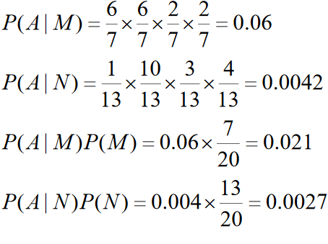
Naive Bayes
Naive Bayesian Classifier formula –
P (A|B) =
P= Probability of two objects A= First object
B= Second object
An example -
where,
P=Probability M=First Object N=Second Object

Slide 8
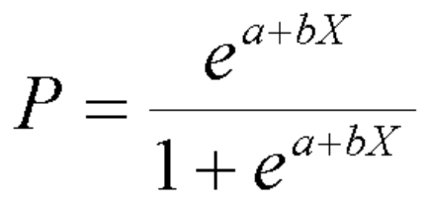
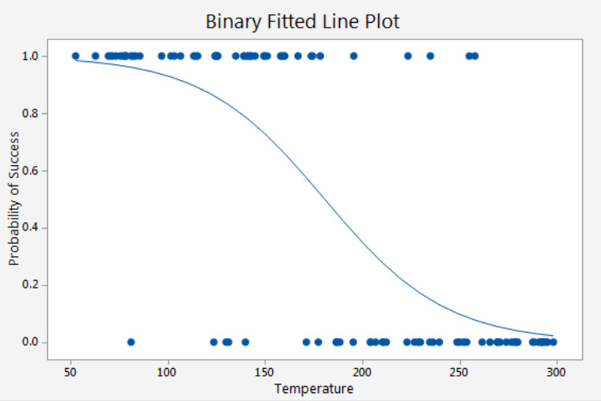
Logistic Regression
Logistic Regression formula,
P = Probability of Positive Occurrence
a , b = Constant
e = Exponential
An example –
The graph shows the curve drawn between probability occurrences of 0 and 1.

Slide 9
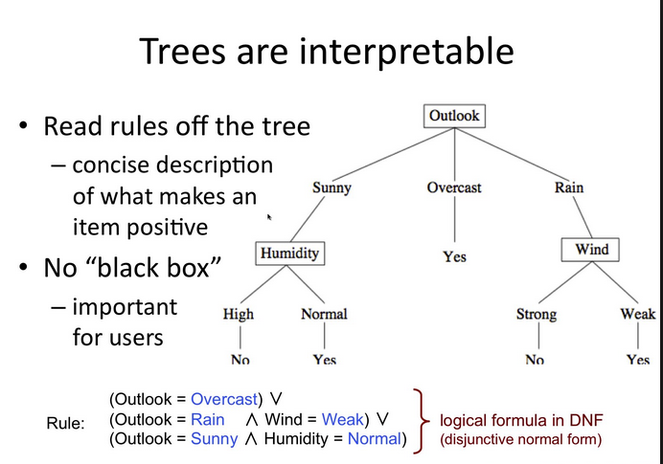
Decision Tree
Entropy(S) = p₊(-log₂p₊) + p₋(-log₂p₋) = -p₊log₂p₊- p₋log₂p
Where, P = Probability of positive occurrence
N.B - Can be generalized to more than two values
An Example -

Slide 10
Advantages and Disadvantages
Authors | Proposed Model | Advantages | Disadvantages
[1]Wang, Qiong, et al. | Naive Bayesian classifier for rapid assignment of rRNA sequences | Simple, fast, highly scalable model building and scoring. | Naive Bayesian classifier creates a strong assumption on the shape of data distribution.
[2]Jindal, Nitin, and Bing Liu. | Review spam detection. | More robust | Logistic Regression requires much more data to achieve stable, meaningful results.
[3]Jotheeswaran, Jeevanandam, and S. Koteeswaran | Decision tree based feature selection and multilayer perceptron for sentiment analysis | Decision trees implicitly perform variable screening or feature selection | Based on heuristic algorithms which fail to offer an assurance of returning the globally optimal decision tree.

Slide 11
Proposed Model
The model is an assembled model of Naive Bayesian, Decision Tree and logistic regression.
All the three classifiers are supervised which requires the class label for training an testing the data.
The advantage of using ensemble model is to improve the accuracy prediction.
Weighted average has been used to predict the final accuracy from all the three classifiers.

Slide 12
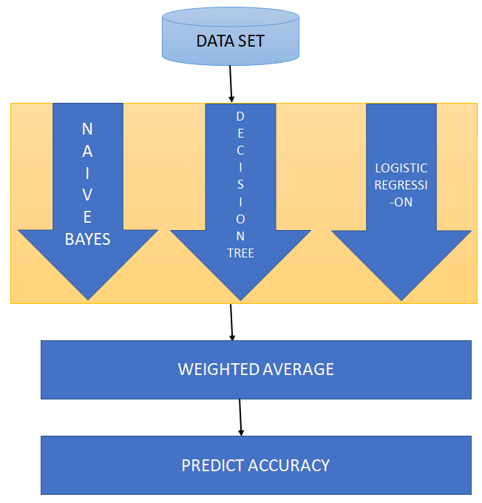
Proposed Architecture

Slide 13
Modules
1. Data Pre-processing
2. Finding the polarity for ensemble model
3. Naive Bayesian prediction
4. Decision Tree prediction
5. Logistic Regression prediction
6. Combining the result using Average of three classifiers
7. Analyze the performance

Slide 14
Performance Metrics
Accuracy: Result of calculation or specification conforms to the correct value or a standard of three algorithms. Accuracy is used as a metric for evaluating the usefulness of one classifier.
Accuracy = TP+TN/TP+FP+FN+TN
Precision: Precision is the ratio of correctly predicted positive observations to the total predicted positive observations
Precision = TP/TP+FP
Recall: Recall section defines that deals with the culmination, or affect ability, of a classifier and measures for output. Recall = TP/TP+FN
Here, TP= True Positive
TN=True Negative
FP=False Positive
FN=False Negative

Slide 15
Performance Metrics – Content
Followings are the implementation steps for the analysis –
Dataset has been taken (In this case twitter dataset)
Performed Cleaning of Dataset to reduce unnecessary words or information
Performed Polarity of ensemble model to get the Positive (True), Negative (False) and Neutral (Balanced) Data.
Accuracy check by three individual algorithm techniques (Naive Bayesian, Logistic Regression, Decision Tree)
Combining the result using Average of three classifiers

Slide 16
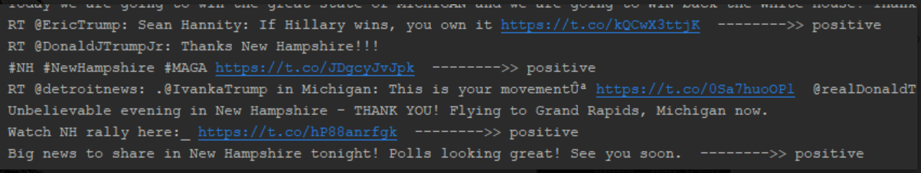
Polarity of Ensemble Model

Slide 17
Performance Metrics - Accuracy
Accuracy check Naive Bayesian Classifier -

Slide 18
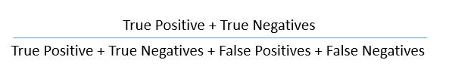
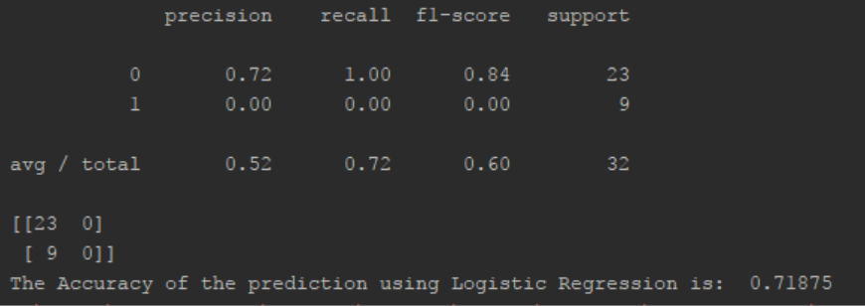
Performance Metrics - Accuracy
Accuracy check by Logistic Regression -

Slide 19
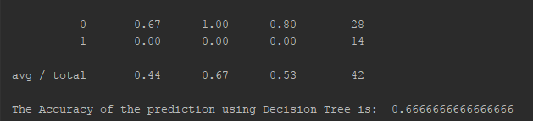
Performance Metrics - Accuracy
Accuracy check by Decision Tree -

Slide 20
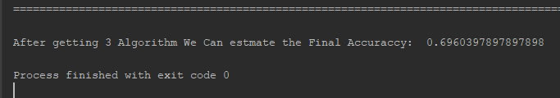
Performance Metrics – Average of ensemble
Final accuracy of ensemble model -

Slide 21
Conclusion
Sentimental Analysis is performed by collecting the tweets and individual pacifiers such as Naive Bayesian Classifier, Decision Tree, and Logistic Regression. The individual three classifier accuracies of 70% for Naive Bayesian Classifier, 71% for Logistic Regression and 66% for Decision Tree Algorithm are obtained. Final accuracy result of 69% is obtain after merging three classifiers together.

Slide 22
References
[1]Wang, Qiong, et al. "Naive Bayesian classifier for rapid assignment of rRNA sequences into the new bacterial taxonomy." Applied and environmental microbiology 73.16 (2007): 5261-5267.
[2] Jindal, Nitin, and Bing Liu. "Review spam detection." Proceedings of the 16th international conference on World Wide Web. ACM, 2007.
[3] Jotheeswaran, Jeevanandam, and S. Koteeswaran. Decision tree based feature selection and multilayer perceptron for sentiment analysis. ; ARPN Journal of Engineering and Applied Sciences 10.14 (2015): 5883-94.

